Slide 1

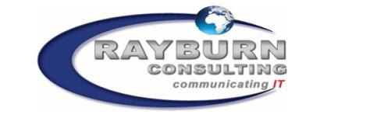
COMPANY PROFILE
Rayburn Consulting Pty Ltd

Slide 2


Table of Contents
Company Overview
Value Offering
Service Offering
Enterprise Performance Management
Industry Experience
Key Differentiators
Our Clients
Contact Us

Slide 3

Company Overview

Slide 4






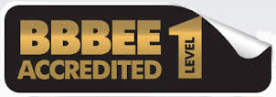
Company Overview
Rayburn Consulting is an established technology partner with Oracle, SAP, IBM, Microsoft and Huawei and has extensive experience in the area of Software development and implementation in Telecoms and Media Solutions, Municipal Service Solutions, Business Process Management, Managed Services, Supply Chain, Governance, Security Management, Infrastructure Management, GRC and Web Services.
Rayburn Consulting is a 100% Black Female Owned Level One (1) B-BBEE contributor. We are wholly South African with broad cross industry experience. We have assisted and worked with many organisations with strategy execution and technology implementation, as well as professional business and system advisory services in South Africa, Africa and the Middle East.

Slide 5

Value Offering

Slide 6
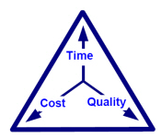
Value Offering
Been There , Done That
Track record of delivering and supporting successful complex systems. Certified associations. Certified References
Right Size Organization
Traded in large estimated revenue. Stable and strong governance.
Multi Vendor Expertise
Oracle, SAP, Microsoft, IBM, Huawei and Hitachi
Un-paralleled Industry experience and availability
Extensive industry experience in handling mission critical systems and applications. 24X7 experts availability to take care of critical applications and databases.
Value pricing and flexibility
Proven successful dual-shore service delivery model with reduced cost of ownership.
Experienced Project Management and Team Leads
Seasoned team of professionals. Great attitude. Ensure successful partnerships with customers.

Slide 7

Service Offering

Slide 8

Service Offerings
Rayburn Consulting
Service Offering
Consulting
Business Process Management
Custom Applications
&
Packaged Applications
Business Intelligence
& Enterprise
Performance
Management
Training
Infrastructure Management

Slide 9
Service Offerings continued
Business Transformation
Business Process Consulting
Domain Consulting
IT Strategy Consulting
Enterprise Architecture Consulting
Business Case Creation
Strategic
Consulting
Global Template Design & Rollout
Consolidation
Globalization
Solutions
End-to-end Implementations
Version Upgrade
Technology Deployment
Implementation & Upgrades
Custom Development
Enterprise Integration
Enterprise Data Management & Portals
Integration & Development
Application Management, Testing
Administrations & Operations
Post Implementation Services

Slide 10

Consulting Services

Slide 11

Consulting Services
Rayburn Consulting has a Specialized staff compliment of professionals
across various Business Areas and Industries, with extensive training and
implementation experience.
We provide Consulting Services across the following areas:
Enterprise Performance Management
Enterprise Resource Planning
Business Intelligence
Financial Services
Business Process Management
Business Applications
Governance, Risk and Control
Customer Relationship Management
Infrastructure Management
Programme and Project Management
Software Customisation and Development
Mobility
Training

Slide 12
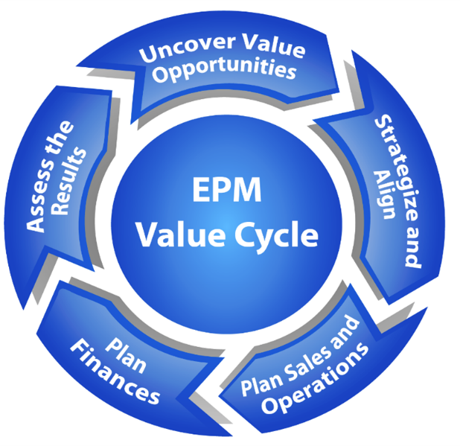
Enterprise Performance Management
      Enterprise Performance Management
      Solutions
      Strategy Management
      Profitability & Cost Management
      Budgeting, Planning and Consolidation
      Enterprise Information Management
      Business Intelligence
      Integrated Reporting and Integrated Thinking
      EPM training and awareness
      Executive Coaching
      Corporate Performance Management
      Customer Management
      Transportation Management
      Demand & Forecasting Management
      Supplier Relationship Management
      Product Lifecycle Management
      Enterprise Resource Planning
      Compliance Management
      Industry Applications
      Technical Infrastructure

Slide 13
The three Key Elements of EPM
Aligned organisation – Agile strategic goal setting and flexible planning
Effective Strategic Planning
Integrated Business Planning
Integrated Resourcing process
Informed organisation – information and insight to support dynamic decision making
Robust operating KPIs and reporting
Integrated cost and profitability management
Advanced Business Analytics
Master Data and Report Management (single version of the truth)
Integrated organisation – Accountability and process to drive achievement of goals
Cascaded Objectives
Management process
Recognised
Cs of X
Business partnering

Slide 14

Enterprise Performance Management
Rayburn specialises in the implementation of Enterprise Performance Management (EPM) solutions with a thorough understanding of how all the EPM methodologies not only integrate but inform each other reciprocally to provide Strategic and Operational insight and simulation.
EPM has been adopted as a set of methodologies and implemented most often in silo’s or in an “integrated” manner that only considers the cross-utilisation of metadata. EPM in its most effective form allows for the interoperability of information across these platforms to allow for the effective implementation of corporate strategy throughout the entire business – an approach that Rayburn has a thorough understanding and vast experience in.
“Rayburn leverages the various methodologies, applications and best practices within EPM to provide a complete range of industry leading advisory and consulting services”
Our advantage over typical advisory and consulting services is that we first and foremost adopt a strong integrated business methodology approach, and accompany this with leading technical expertise to accurately enable technology to support the business design.

Slide 15
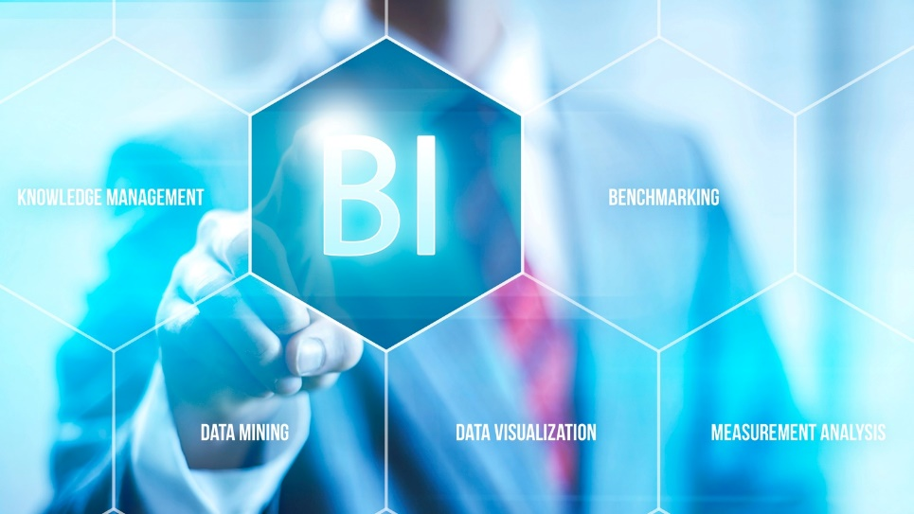
Business Intelligence
Rayburn Consulting offers a portfolio of various Business Intelligence products and solutions, providing critical intelligence to decision makers and influencers within several industries.
We provide predictive and actionable intelligence that enables strategic and operational decision making and can be a game-changer for a business.
Our Business Intelligence Solutions
Our aim is to empower you with industry intelligence that will enable you to make smarter commercial decisions faster for accelerated growth.
Products and services:
1. Insight
Real-time news
Trends
Market analysis
Special reports
2. Intelligence
Real-time data
Predictive analysis
Deep data pools
Client-dedicated support
3. Bespoke Solutions
Consultancy
Advertising
Events
Bespoke reports

Slide 16

Business Process Management
We focus on improving corporate performance by managing and optimising a company's business processes.
We ensure that company’s become more efficient, more effective and more capable of adapting to an ever-changing environment.
Our objective is to ensure that we provide our clients with value-added products and services.
In our approach we make use of various Business Process Improvement Methodologies such as Business Process Mapping, Six Sigma (DMAIC), Lean Sigma and other tools.
Our Business Process Management involves a combination of modeling, automation, execution, control, measurement and optimization of business activity flows, in support of enterprise goals, spanning systems, employees,
customers and partners within and beyond the enterprise boundaries.
We employ a disciplined approach in assisting clients to identify, design, execute,
document, measure, monitor, and control both automated and non-automated business
processes to achieve consistent, targeted results aligned with an organization’s
strategic goals.
Rayburn enable clients with the deliberate, collaborative and
increasingly technology-aided definition, improvement, innovation, and
management of end-to-end business processes that drive business results,
create value, to ensure an organization meets its business objectives with
more agility.

Slide 17
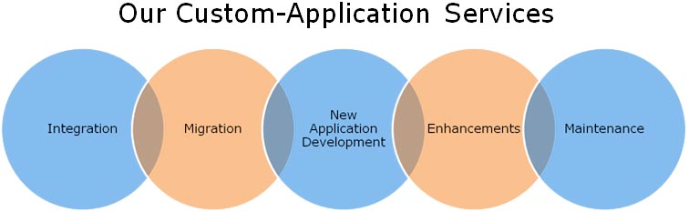

Custom Applications
We provide custom software development services that are tailored around the organizations specific needs.
The benefits of our custom designed software is the simple fact it provides features off-the-shelf software doesn’t. Designing an application with your organization’s needs in consideration implies an increased level of productivity.
We follow a structured SDLC methodology and strive to be agile and flexible in order to meet our client’s unique requirements.

Slide 18

Package Applications
Rayburn has a very skilful team of specialists who have extensive knowledge of Packaged Application implementations, across various industries.
Our software knowledge includes:
Oracle
Microsoft
SAP EPM
Business Intelligence
Business Objects
SAS
Pluss Solutions

Slide 19

Infrastructure Management
We specialize in the management of essential operation components, such as policies, processes, equipment, data, human resources, and external contacts, to ensure overall effectiveness for our clients.
Some of the key benefits of our Infrastructure Management services:
Reduce duplication of effort
Ensure adherence to standards
Enhance the flow of information throughout an information system
Promote adaptability necessary for a changeable environment
Ensure interoperability among organizational and external entities
Maintain effective change management policies and practices

Slide 20

Training
  Enterprise performance management
  Integrated business planning and performance management (Turning strategy in to action)
  Strategic scorecards, KPI identification and linkages to lower levels
  Activity based costing, (ABC), and management (ABM)
  Value chain analysis
  Value and cost driver analysis
  Budgeting and forecasting.
  Integrated reporting and Integrated Thinking
  Scorecards and Dashboards
  Causal analysis
  Benchmarking
  Supply Chain management and unlocking value in the supply chain
  Business case development - What makes a good business case
  Project evaluations (DCF NPV payback etc.) and risk assessment
  Benefits tracking

Slide 21

Industry Experience

Slide 22
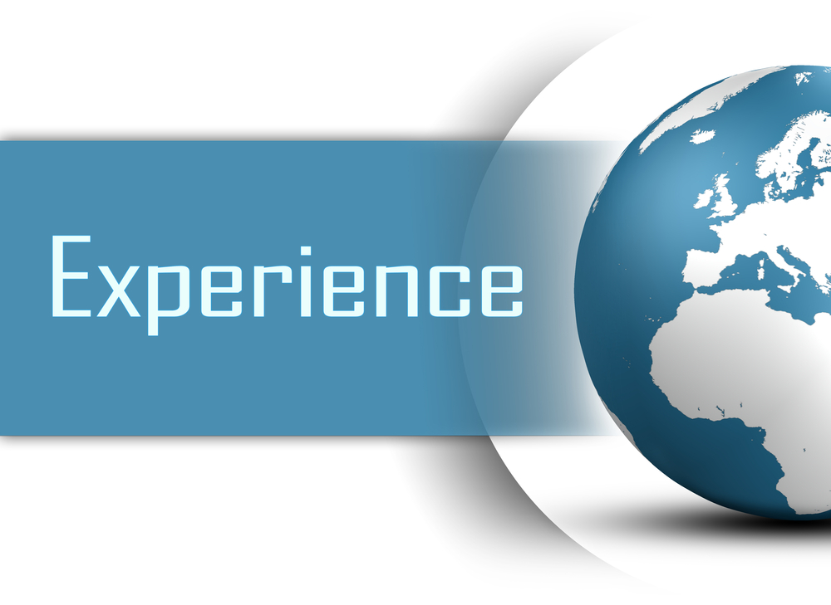
Industry Experience
Industries
Local , Provincial and National Government
Public Sector
Banking, Insurance & Financial Services
Telco
Gaming
Manufacturing
Healthcare
Utilities
Oil & Gas
Communications & Media

Slide 23

Related Experience
Our consulting team consists of a number of highly skilled individuals who are dedicated to the implementation of EPM and can be classed to be amongst the bests in the field. The team hosts skills relating to Performance Management, Business Analysis, Process Analysis, EPM methodology, Business Modeling, Data Integration and Automation.
Our team has an excellent technical understanding of the various ICT solutions. Our implementation, training, and consulting skills are unmatched and will ensure the maximum return on any software investment.
Rayburn resources have vast experience in the various pillars of EPM, with many implementations across all industry sectors. These resources have delivered turnkey solutions in the following industries:
Financial Services (Nedbank, FNB, RMB, Old Mutual, Sefa)
Healthcare (Netcare, Gauteng Department of Health)
Industrials, Manufacturing and Mining (Foskor, De Beers, Scaw Metals)
Logistics and Transportation (XPS, UTI, Transnet)
Provincial, National and Local Government (Buffalo City Municipality, City of Johannesburg, City of Cape Town, National Treasury, Nelson Mandela Bay Metropolitan Municipality, Department of Health, DoJ, Ekurhuleni)
SOCs (Eskom, ATNS, ACSA, Independent Development Trust, Transnet)
Telecommunications (Telkom, MTN, Telecom Namibia, Ghana Telecoms, MTN Ghana)
FMCG and Retail (EDCON, Mr Price Group, Tsogo Sun)

Slide 24
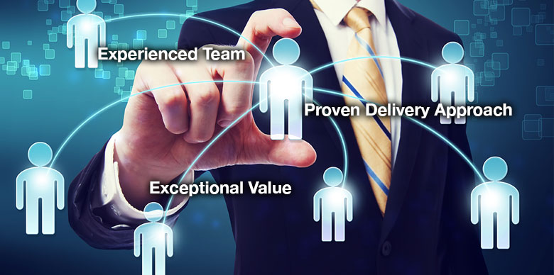
Key Differentiators

Slide 25

Key Differentiators
Specialised industry experience.
Staff compliment with Unique skill sets.
Very strong strategic alliances and partnerships with industry leaders.
Track record of delivering and supporting successful complex systems.
Focused approach in understanding our customer’s real needs.
We have a “feet on the ground approach”.
Agility and Flexibility. Fast to market.
We provide solutions with a distinctive level of professionalism and service.
We focus on time, quality and cost in order to provide our clients with the assurance that their needs are our priority.

Slide 26

Contact Us
South Africa Office
Saldomax House| 25 Autumn Street| Rivonia| Johannesburg| South Africa
Office: +27 10 593 0595
Ghana office
Stanbic Heights, G15 |Intersection of Liberation road and North Liberation link | Airport city | Accra, Ghana
Office: +233 (0) 20 007 9793 |
Dubai Office|#110, EIB 04, Dubai Internet City|PO Box 502134, Dubai, United Arab Emirates.
Cell:+27 82 722 6311
|www.rayburn.co.za |

Slide 27
Thank You!

